Slide 1
"A Holy Attitude"
1 Peter 3:13-17

Slide 2
Definition: Attitude - a settled way of thinking about someone or something, typically one that is reflected in a person's behavior" (Oxford Dictionary)

Slide 3
Definition: Submission - "to yield and humbly come under an authority other than yourself" (Pastor Rick)

Slide 4
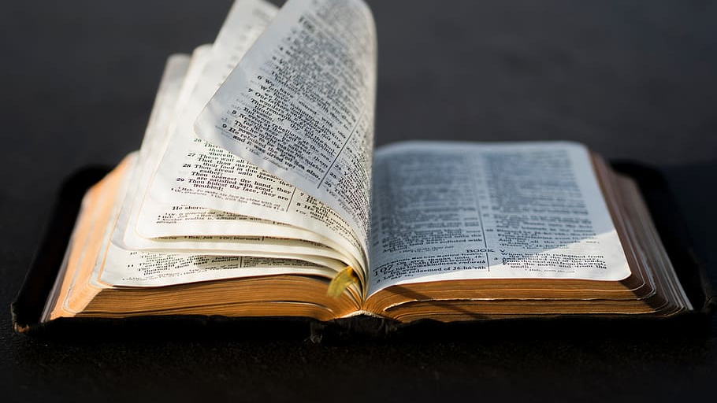
1 Peter 3:13-17 verse by verse

Slide 5
Four Steps in Developing A Holy Attitude 1 Peter 3:13-17
1. Follow The Right Plan v13; 1 Peter 2:4-5, 9

Slide 6
Four Steps in Developing A Holy Attitude 1 Peter 3:13-17
1. Follow The Right Plan v13; 1 Peter 2:4-5, 9
2. Understand Suffering v14; 1 Peter1:6, 5:10; John 6:68

Slide 7
Four Steps in Developing A Holy Attitude 1 Peter 3:13-17
1. Follow The Right Plan v13; 1 Peter 2:4-5, 9
2. Understand Suffering v14; 1 Peter1:6, 5:10; John 6:68
3. Consecrate Jesus in Your Heart v15; Matthew 6:33; Colossians 3:1-2; Matt 5:5

Slide 8
Four Steps in Developing A Holy Attitude 1 Peter 3:13-17
1. Follow The Right Plan v13; 1 Peter 2:4-5, 9
2. Understand Suffering v14; 1 Peter1:6, 5:10; John 6:68
3. Consecrate Jesus in Your Heart v15; Matthew 6:33; Colossians 3:1-2; Matt 5:5
4. Maintain a Good Conscience v16; Romans 12:18; 1 Timothy 3:9

Slide 9
"A Holy Attitude" 1 Peter 3:13-17
Follow the Plan - Understand Suffering - Consecrate Jesus - Maintain Conscience
"But sanctify the Lord God in your hearts, and always be ready to give a defense to everyone who asks you a reason for the hope that is in you, with meekness and fear" 1 Peter 3:15

